Slide 1
Chapter 6 Recursion
By
Hyung Jae (Chris) Chang
Troy University

Slide 2

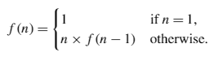
Recursion
A recursive function is a function that makes calls to itself; this works like the loops that we saw in the previous chapter.
Two components in recursive function
Base case: the smallest input and has an easily verifiable solution
Recursive step: the set of all cases where a recursive call is made.

Slide 3
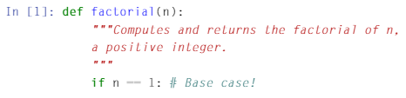
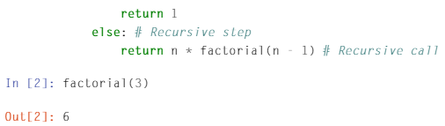
Example 1
Factorial

Slide 4
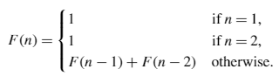
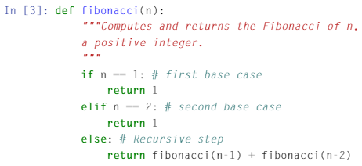
Example 2
Fibonacci numbers

Slide 5
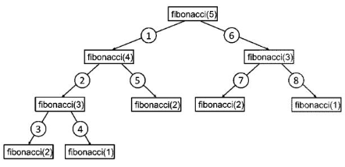
Example 2 (cont.)
Fibonacci numbers

Slide 6
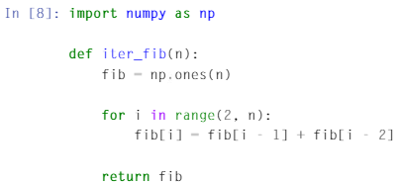
Example 2 (cont.)
Fibonacci numbers

